Slide 1
Annual E-Plan Tier II Filing Workshop
State of Florida Emergency Response Commission
Notes:
Welcome attendees. Introductions.

Slide 2
https://erplan.net/eplan/home.htm
Notes:
If you have brought your laptop, please type this link into your web browser to go to E-Plan.

Slide 3
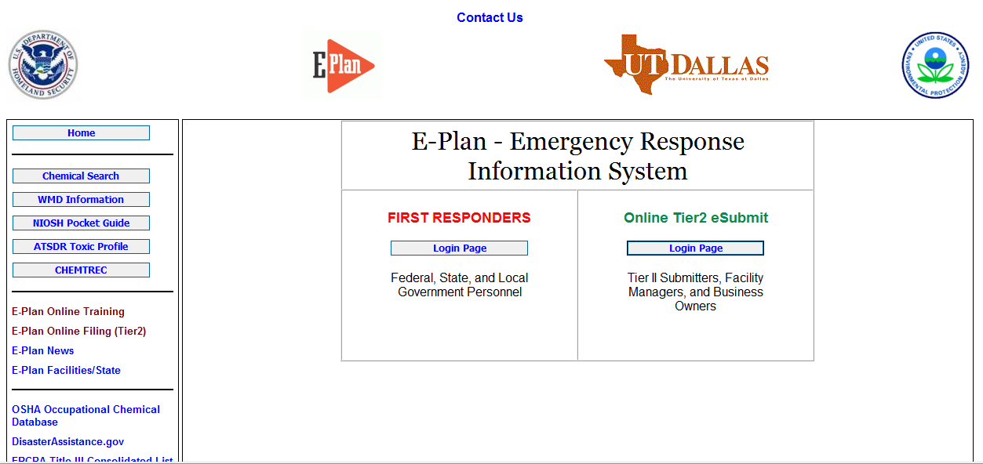
Getting Started
Click here to file Tier II report in E-Plan.
Notes:
Your page should look like this.
*Animation* Filers click on the login page button under Online Tier2 eSubmit.

Slide 4
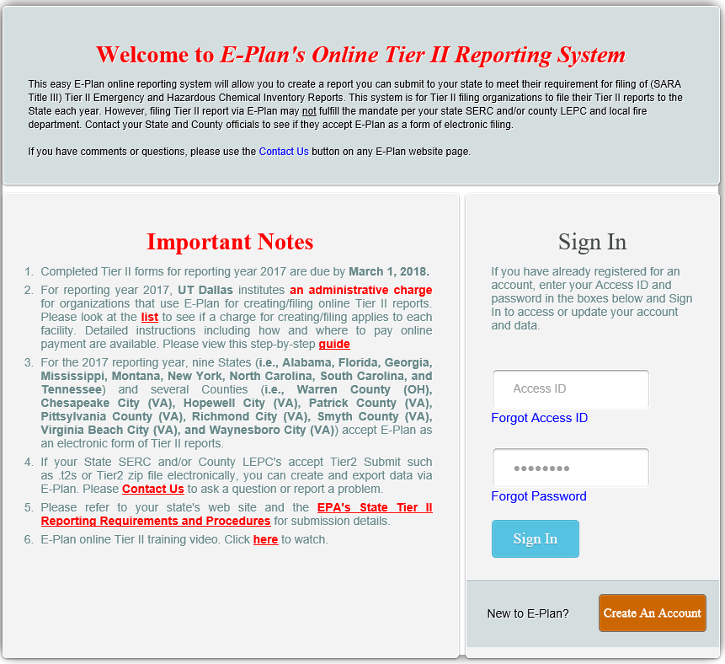
Admin fee paid by State of Florida
Notes:
*Animation* UT Dallas (E-Plan developer and administrator) charges a fee, however it is paid by the state of Florida.
*Animation* If you already have an Access ID, you will type it in here. If you don’t know your login, or if you are uncertain if your facility has an existing login, you may contact us at DEM to retrieve that information.
*Animation* If your facility is a new filer in the State of Florida, you will click on ‘Create New Account’.

Slide 5
Please Note
Do not create a new account if your company filed last year.
Notes:
*Emphasize this point!*

Slide 6
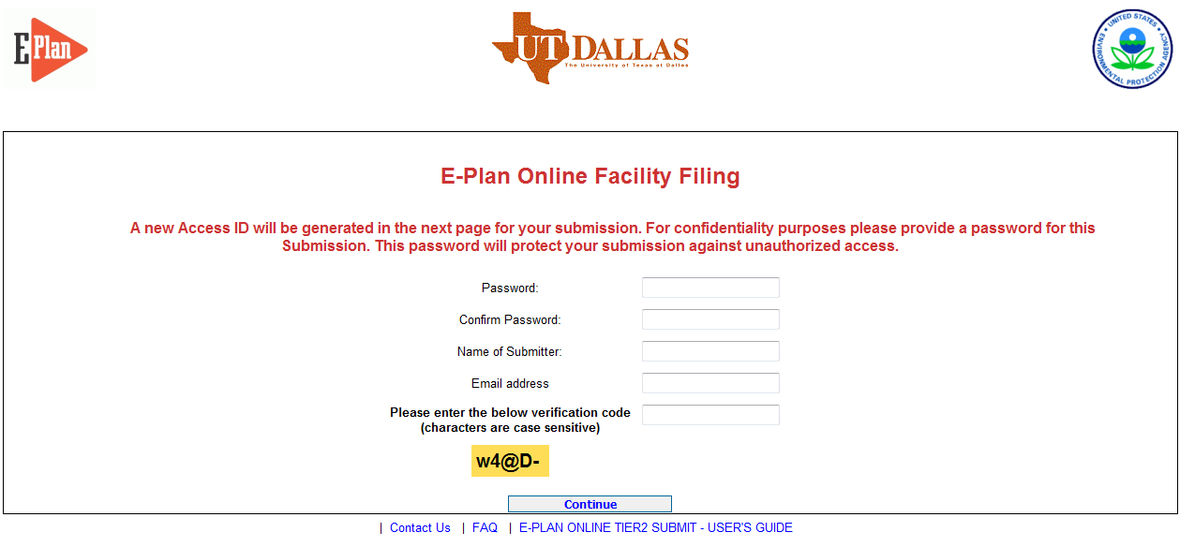
Fill out above information and a unique Access ID will be sent to the email provided.
Notes:
If you must create a new login, fill in the requested information and your Access ID will be emailed to you.

Slide 7
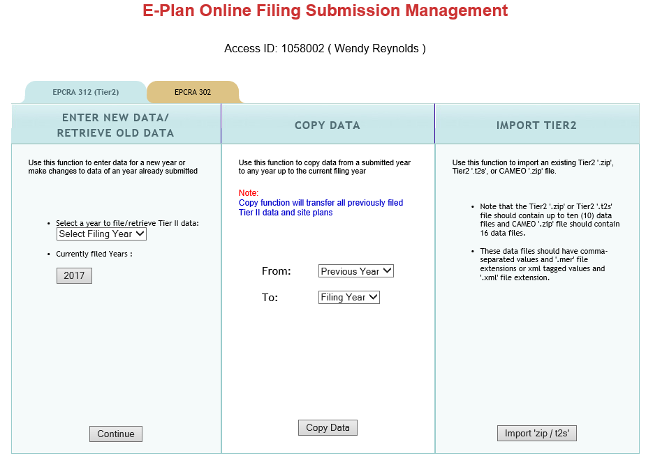
Florida filers don’t click on this tab.
Select 2017
Select 2018
Notes:
*Animation* Do not click 302 tab.
*Animation* New filers will go to the first column and select a filing year from the drop down box and click ‘continue’.
*Animation* Existing facilities will go to the 2nd column and copy from the previous year to the next filing year and click ‘copy data’. Once the data is copied and ready a message will flash in red to ‘click here’.

Slide 8
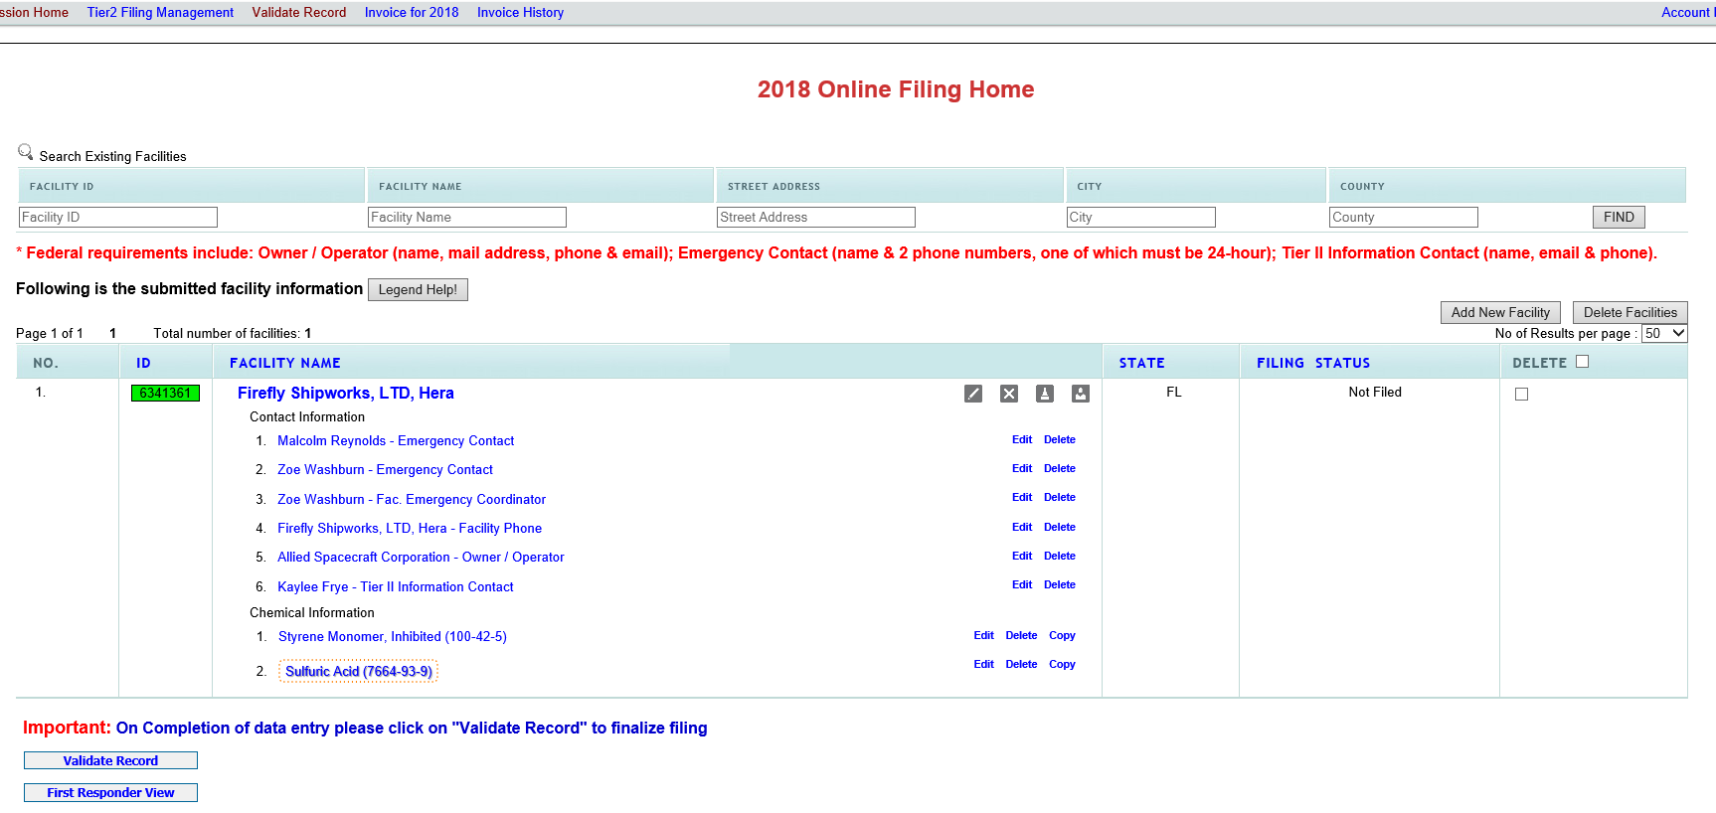
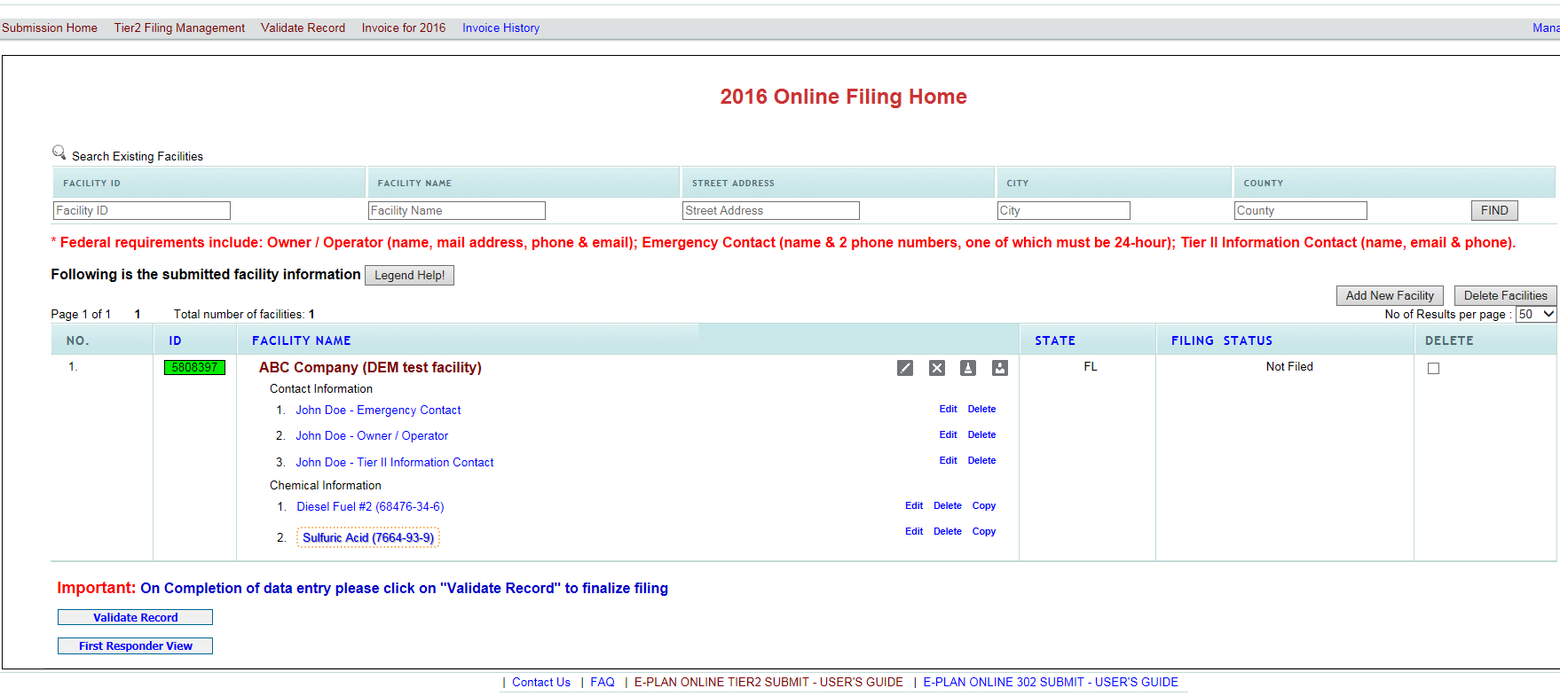
Tier II Filing Management
Verify facility info
Use these icons to edit or delete a facility, add a new chemical, or add a new contact.
Current filing status.
Notes:
*Animation* If you are a new filer or need to file for new facilities, click ‘Add New Facility’. *Remark on ‘Delete Facilities’*
*Animation* Discuss edit, delete, add chemical, add contact icons
*Animation* Discuss ‘Tier2 Filing Management’ header to return to filing home
*Animation* Note filing status
*Animation* Discuss reviewing/verifying facility info
*Animation* Discuss green box

Slide 9
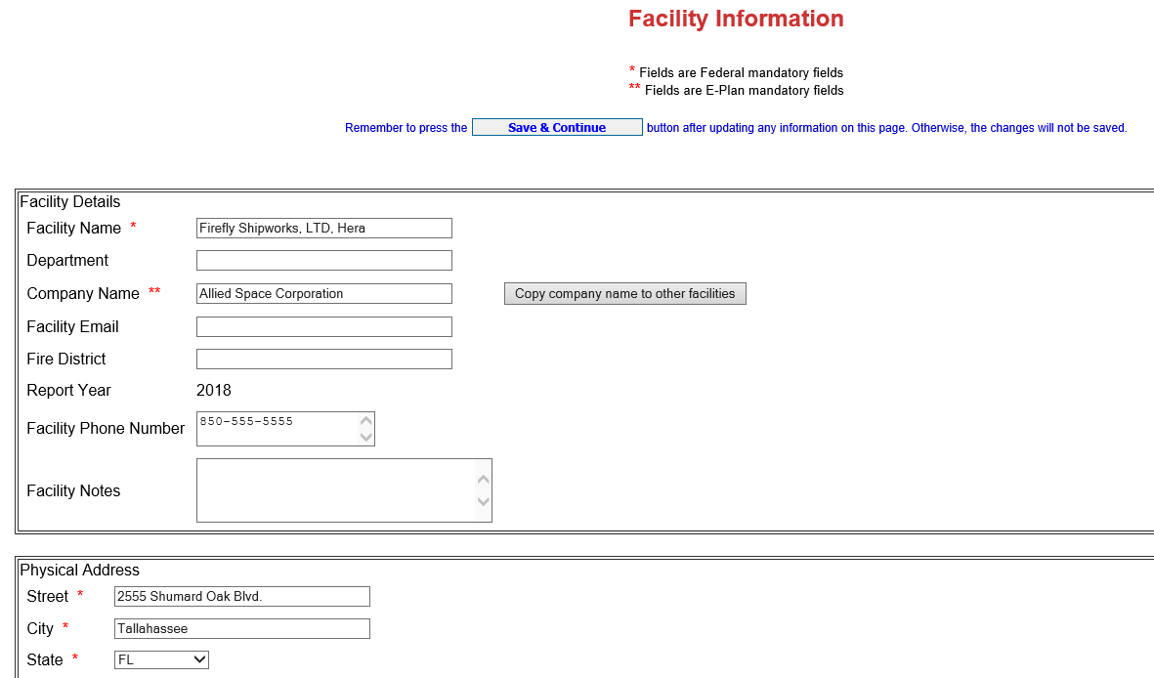
Confirm Facility Information
Add to notes if facility:
Has been sold
Changed Name
Chemicals were removed
No longer operational.
Notes:
*Animation* Discuss adding facility notes

Slide 10
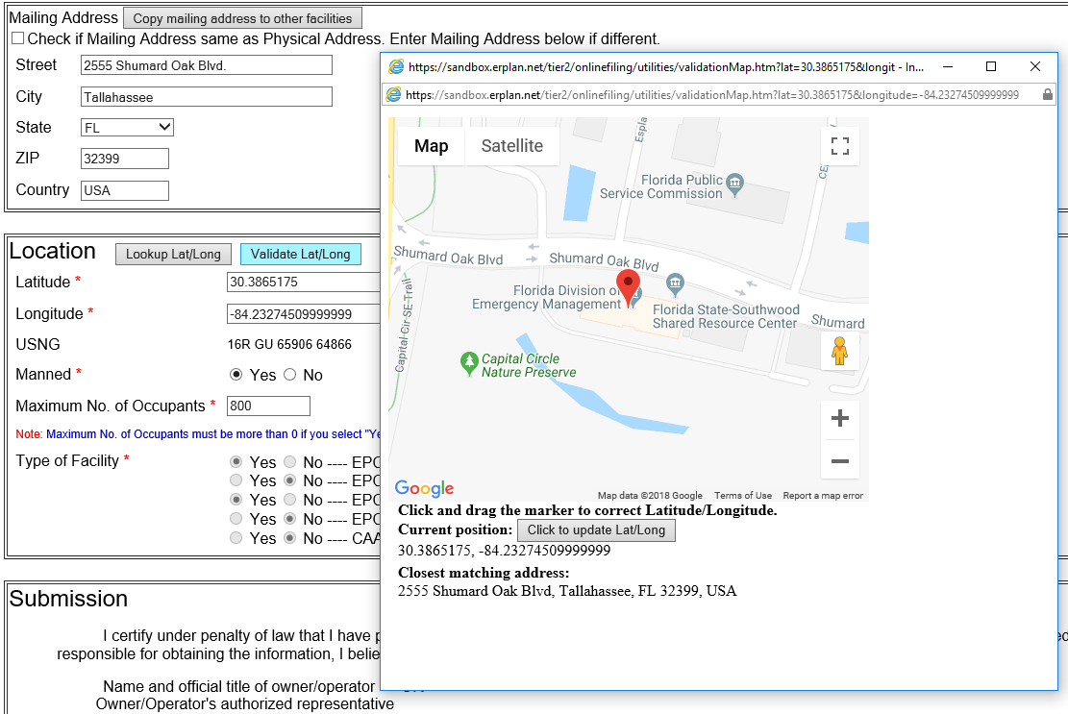
Confirm Facility Information (cont’d.)
Notes:
*Animation* Discuss Lat/Long

Slide 11
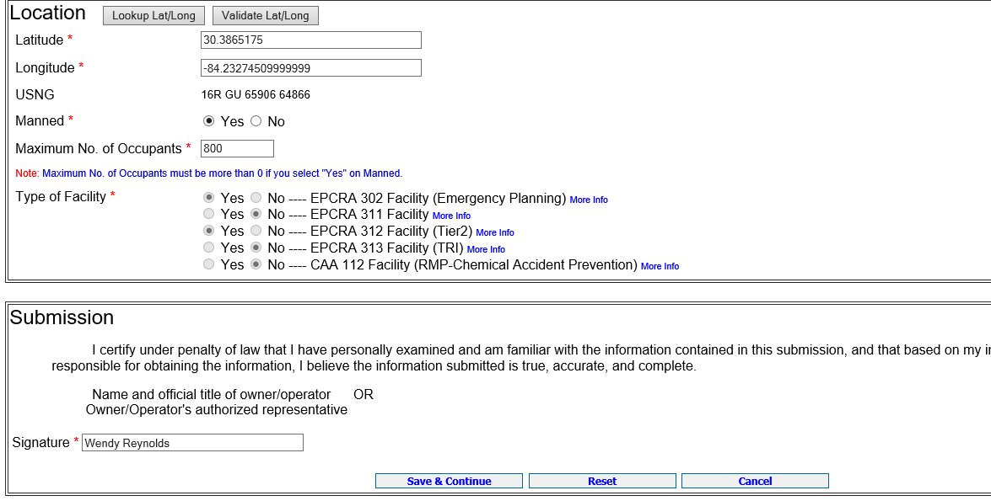
Confirm Facility Information (cont’d.)
Signing the Tier II report
Notes:
*Animation* Discuss updating authorized representative signature

Slide 12
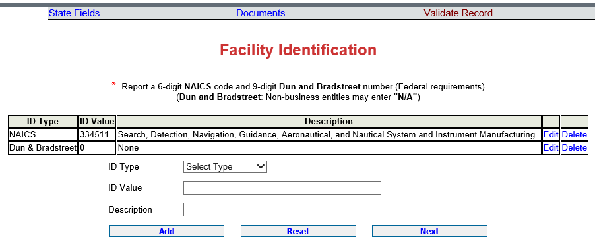
Confirm Facility Information (cont’d.)
Required data
To find your Dun and Bradstreet number go here:
http://mycredit.dnb.com/search-for-duns-number/
To find your 6-digit NAICS code go here:
http://www.naics.com/search/

Slide 13
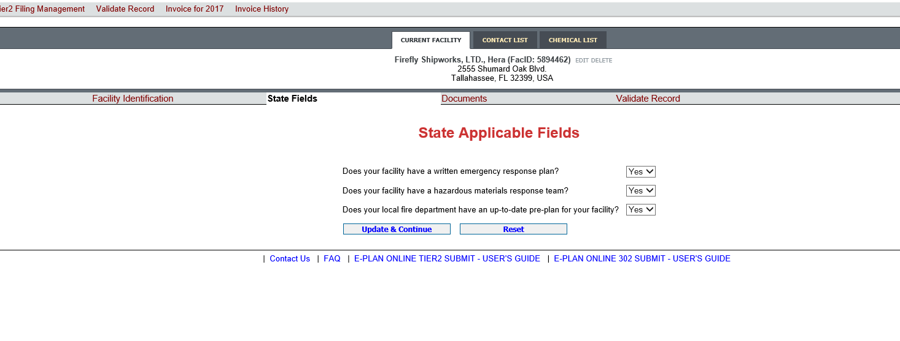
Confirm Facility Information (cont’d.)
Notes:
This slide is pending new State Defined fields – Facilities: 1. 3 yes/no questions

Slide 14
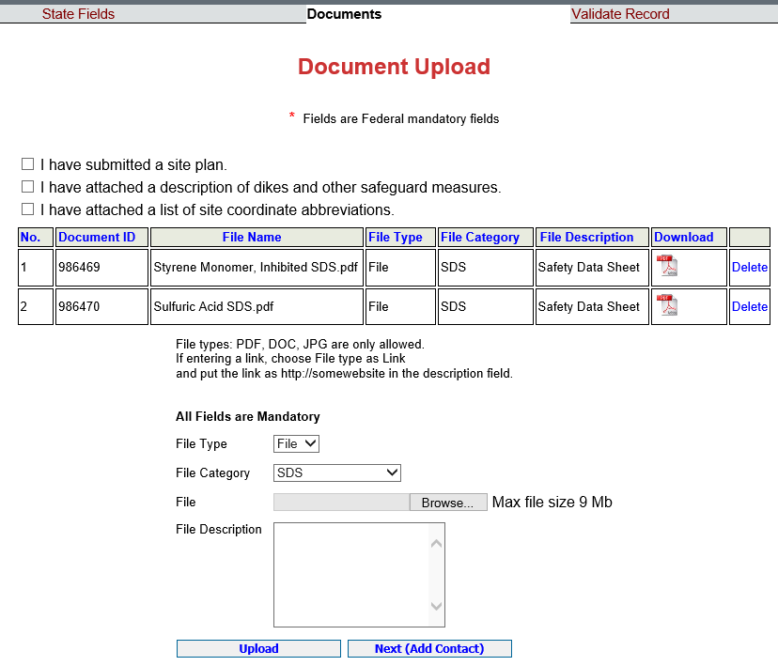
Confirm Facility Information (cont’d.)
Please upload a site drawing. You may also add SDSs, SODs, and other documents.

Slide 15

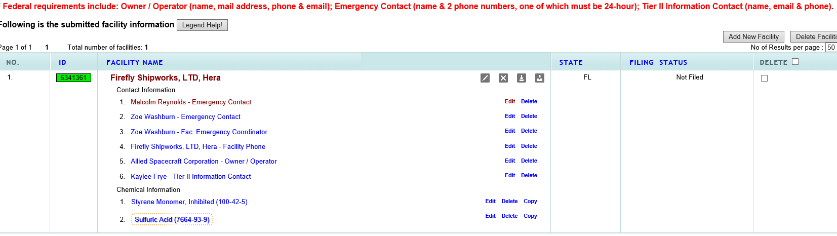
Confirm Contact Information
Click on name or edit to access contact info.
Notes:
*Animation* Discuss how to edit contact info

Slide 16
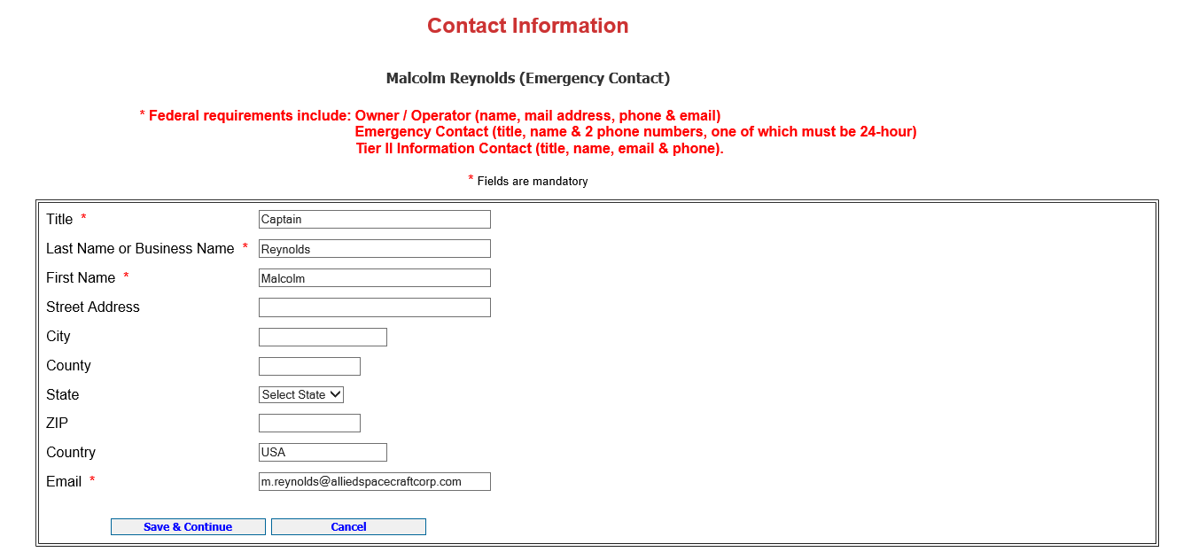
Confirm Contact Information (cont’d.)
Required data
Notes:
Discuss required contact data

Slide 17
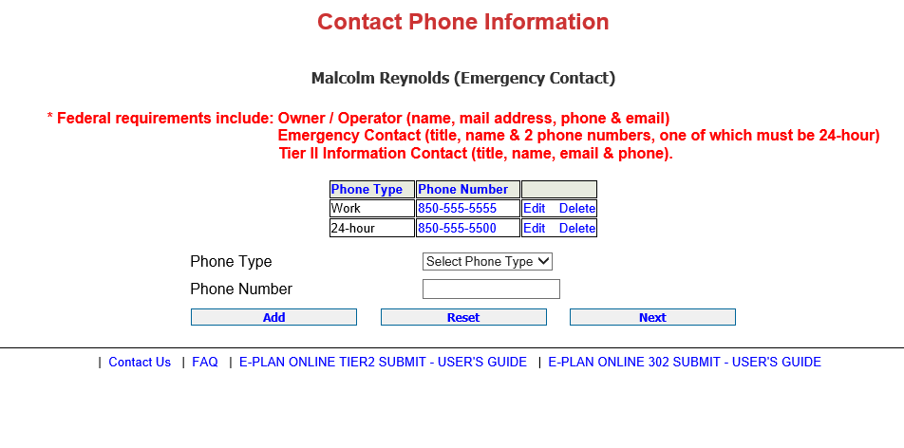
Confirm Contact Information (cont’d.)
Minimum Federal requirements.
Notes:
Discuss minimum requirements

Slide 18
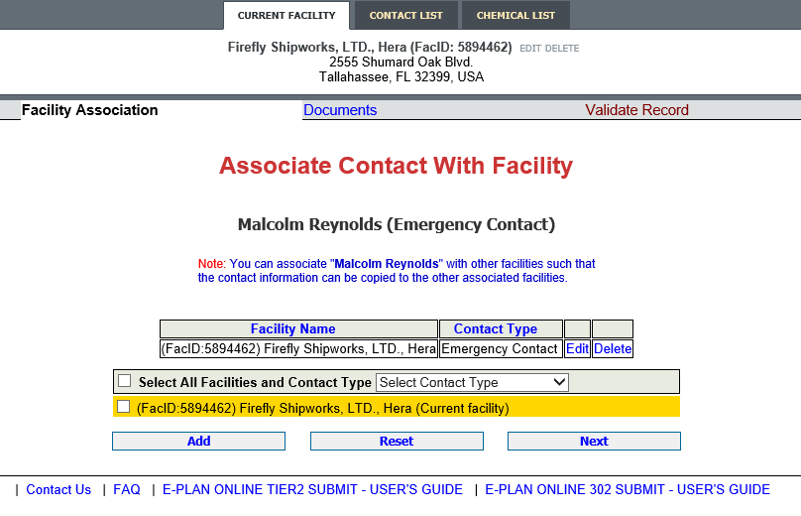
Confirm Contact Information (cont’d.)
If you have more than one facility, you may add the same Contact person by selecting specific facilities and the drop down to select the specific contact type and then click Add.
If you only have one facility, click Next.
Notes:
Discuss adding to more than one facility or adding same contact with different designation (ex. Emergency and Tier II) to same facility.

Slide 19
Confirm Chemical Information
Click on either link to access chemical information.
Notes:
Discuss how to edit existing chemical info

Slide 20
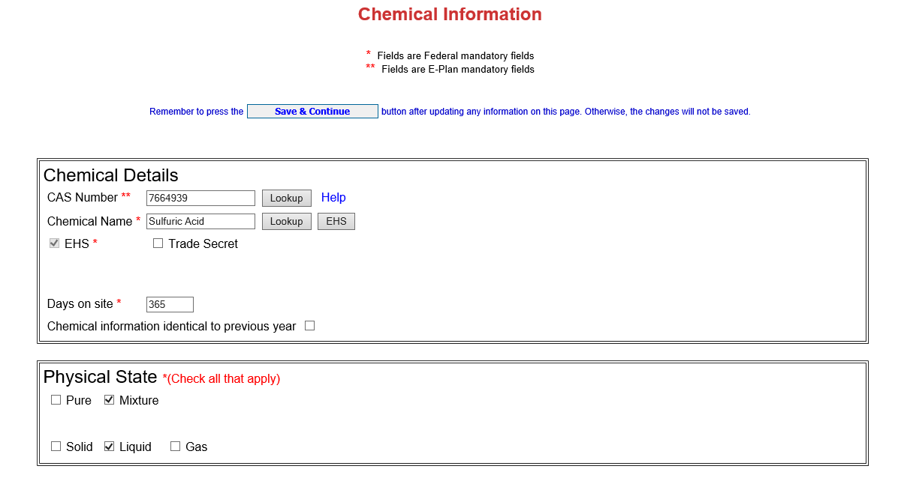
Confirm Chemical Information (cont’d.)
Note that sulfuric acid is an extremely hazardous substance
Notes:
*Animation* Discuss EHS designation
*Animation* and reporting in pounds

Slide 21
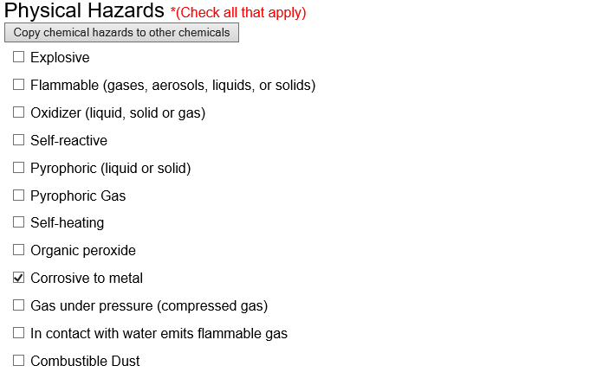
Confirm Chemical Information (cont’d.)
Notes:
Discuss the new EPA physical and health hazard reporting requirements. Not currently in E-Plan, but will likely be there for 2017 filing.

Slide 22
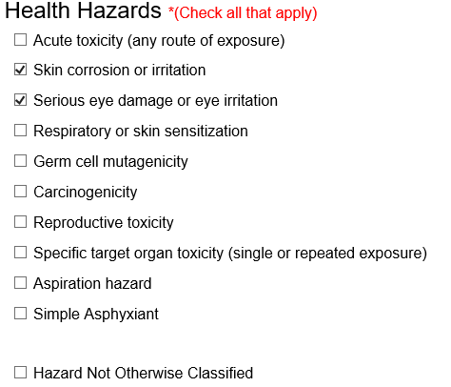
Confirm Chemical Information (cont’d.)

Slide 23
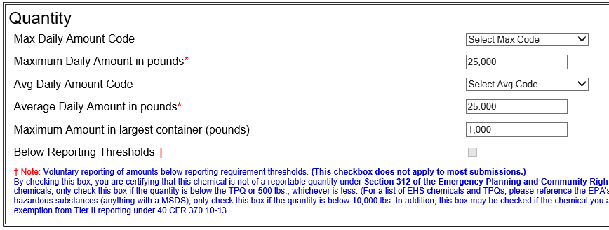
Confirm Chemical Information (cont’d.)
Always enter amounts in pounds

Slide 24
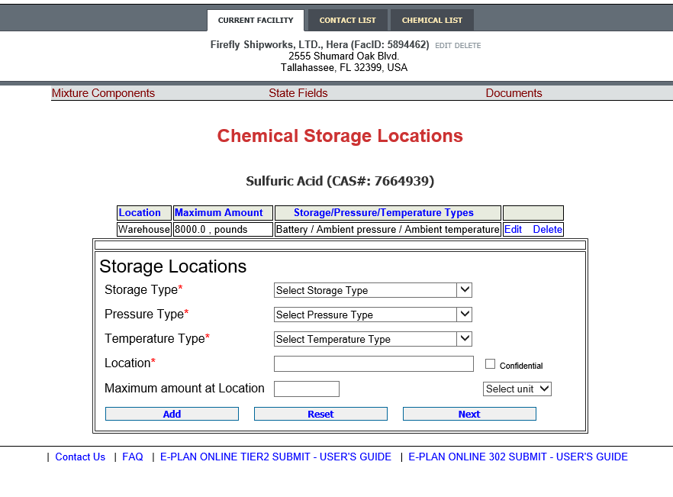
Confirm Chemical Information (cont’d.)
Existing location
Can add multiple locations as needed
Notes:
Discuss entering/editing storage locations

Slide 25
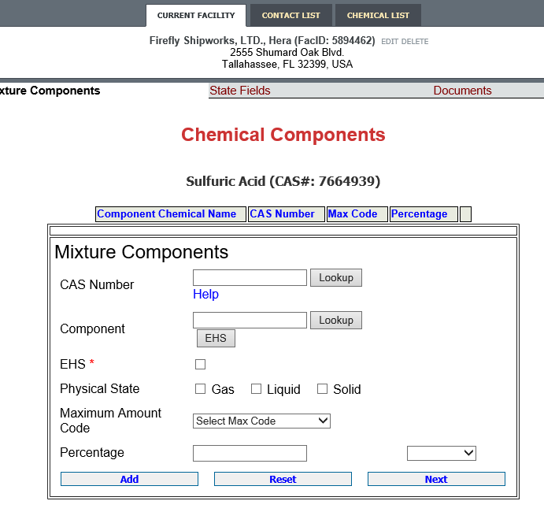
Confirm Chemical Information (cont’d.)
Adding a Mixture Component is optional.
Either Add the Mixture Component by entering the necessary fields and clicking Add or if there is no Mixture Component, click Next.
Notes:
Discuss how it is probably best not to use this part of E-Plan.

Slide 26
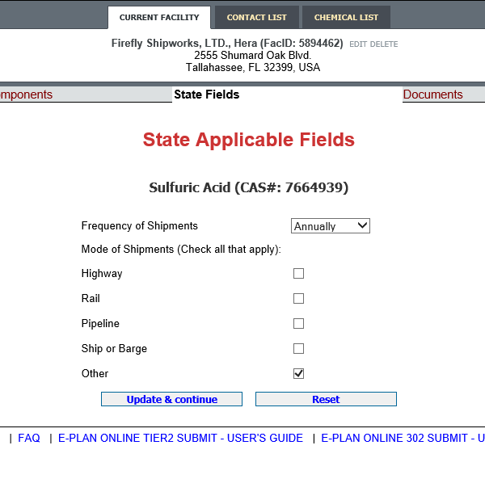
Confirm Chemical Information (cont’d.)
Frequency and Mode of Shipments refers to how often chemicals are shipped to the site.

Slide 27
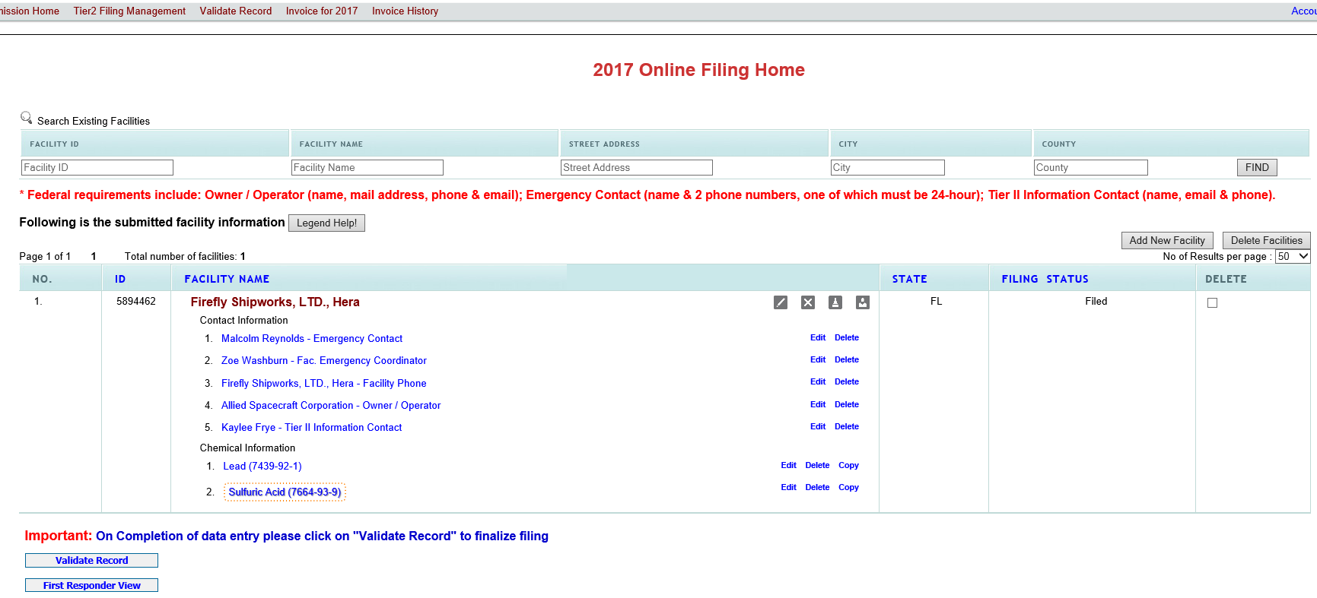
Validate Record
Current filing status
Notes:
*Animation* Note filing status.
*Animation* Click validate record to check your filing and start the final process of uploading data to E-Plan and paying fees.

Slide 28
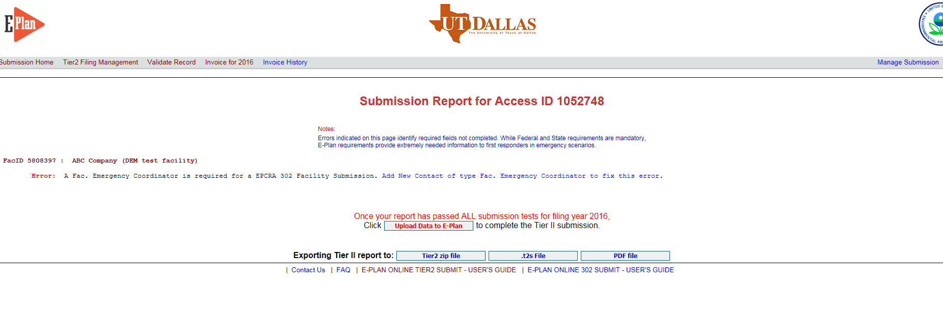
Validate Record (cont’d.)
If an error message occurs, click the blue link next to the requirement. This will bring you to the page necessary to satisfy the requirement.
Notes:
Oops, we had a problem! Discuss how to fix it.

Slide 29
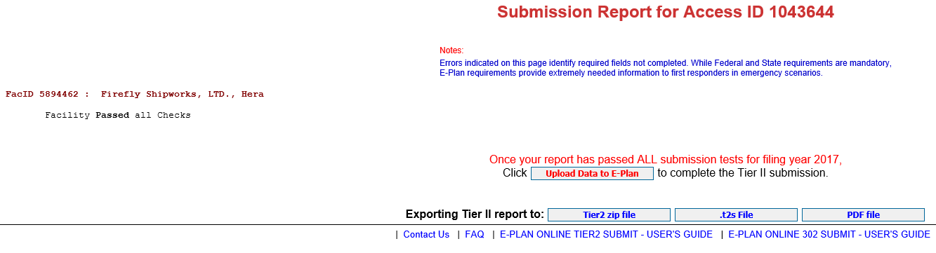

Validate Record (cont’d.)
With all errors corrected, the Tier II data can be uploaded to E-Plan.
Notes:
Once facility has passed, upload to E-Plan.

Slide 30
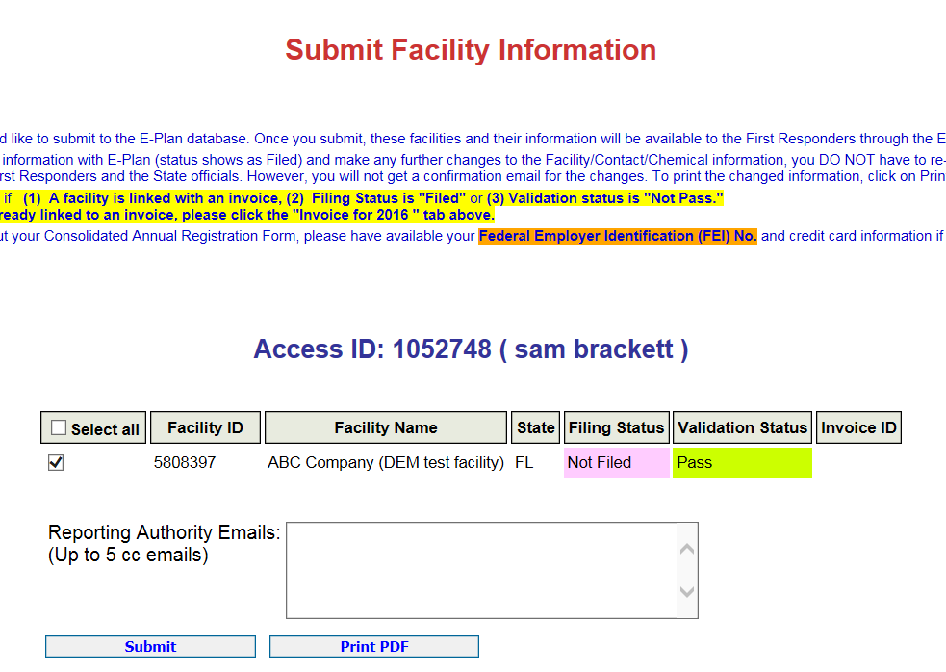
Validate Record (cont’d.)
Select facilities to upload.
Note that you can print a draft copy Tier II report before final upload.
Notes:
*Animation* Discuss printing draft copy of Tier II
*Animation* Select facilities to upload

Slide 31
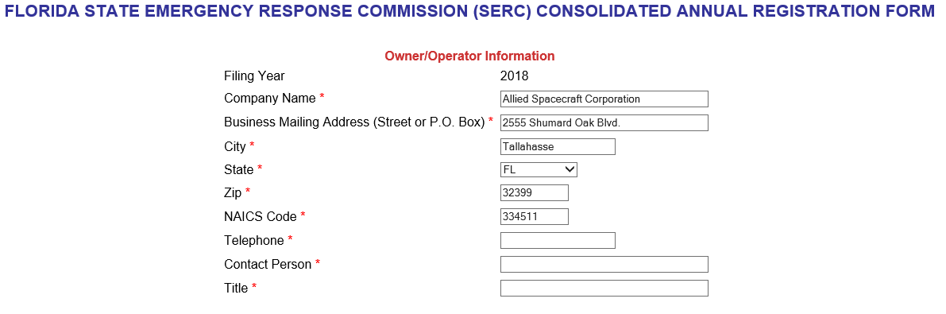
Consolidated Annual Registration Form
Note all fields are required.

Slide 32
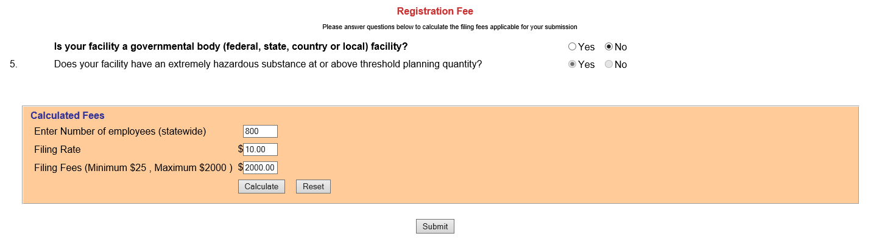
Fee Calculation and Payment
Note the fee rate is determined by your reported chemicals and answers to these questions.
Enter # of employees, then click on “Calculate”
Click ‘Submit’ to pay online.
Notes:
*Animation* Discuss fee questions
*Animation* Calculate fees
*Animation* Submit to pay online

Slide 33
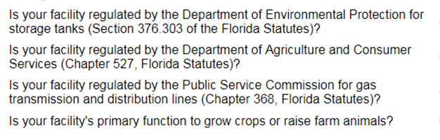
Other Fee Questions

Slide 34
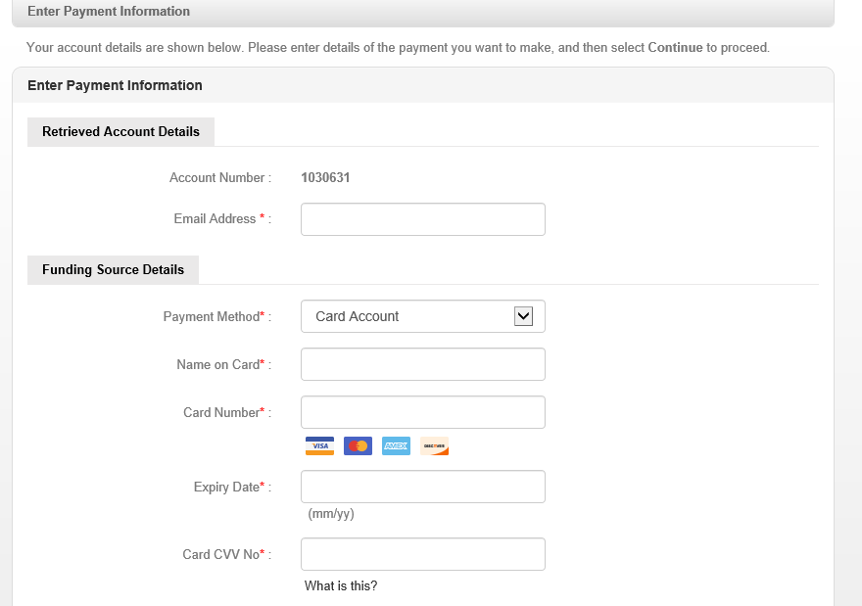

Slide 35
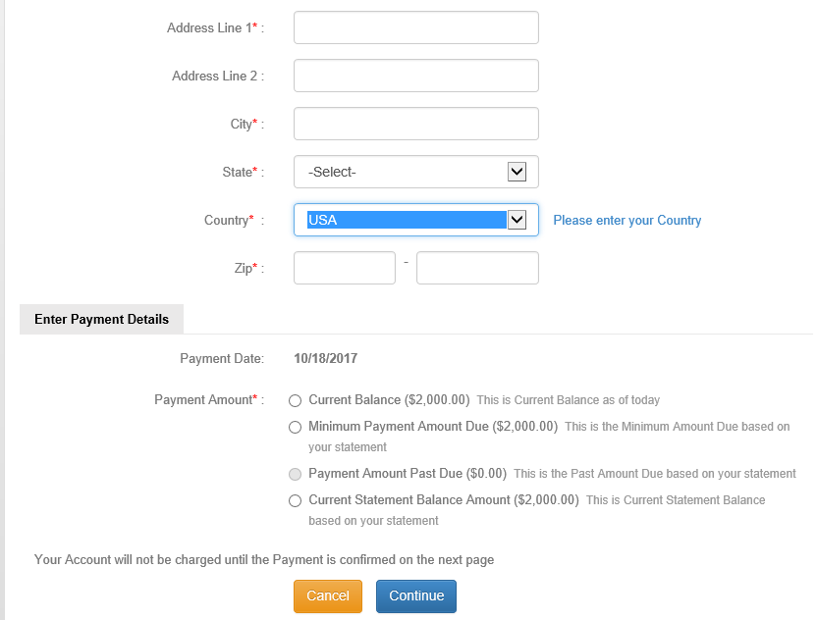

Slide 36
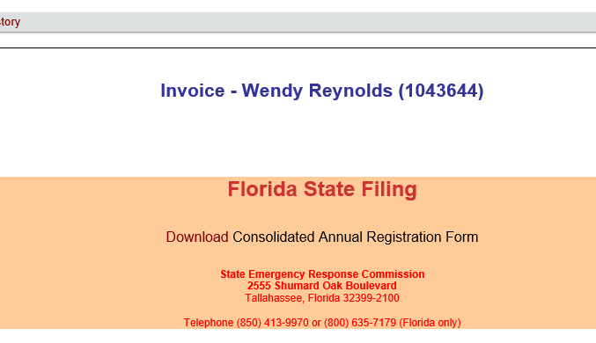
Link to print copy of the fee form.

Slide 37
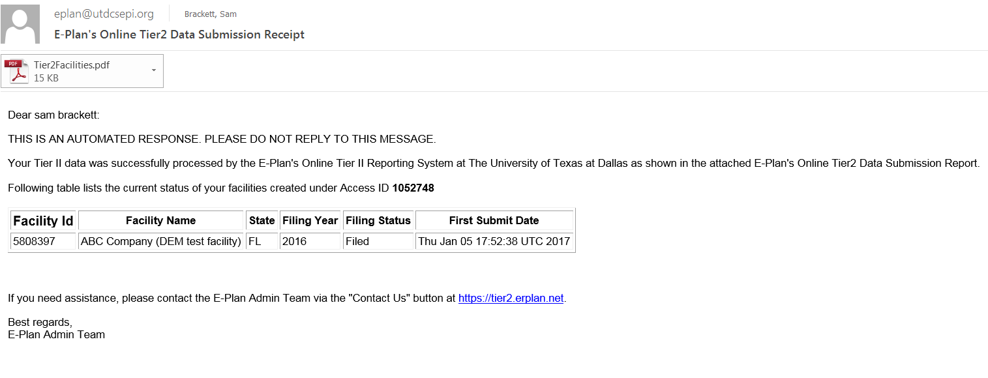
Email confirmation – Tier II Filed
PDF copy of the Tier II Report.

Slide 38

State Facility Representatives
Sam Brackett 850-815-4323 Sam.Brackett@em.myflorida.com Call if your NAICS code begins with: 62, 22, 92, 81, 21, 72 | Wendy Reynolds 850-815-4317 Wendy.Reynolds@em.myflorida.com Call if your NAICS code begins with: 11, 31, 33, 44, 45, 52, 54, 55, 56, 61, 71
Trisha Tidwell 850-815-4322 Call if your NAICS code begins with: 23, 42, 51, 53, 48, 49 | Your NAICS code can be found at: http://www.naics.com/search/

